Slide 1
Irrigation Monitoring with Control System using IoT
Team Members : Under the Guidance of Anand Prakash Rawal Sir
Vivek Bharati 15107030
Balkaran Kumar 15107010

Slide 2
Why this Project ?
Farmers usually work on large portions of land to grow different types of crops. It is usually not always possible for one person to be able to keep track of the entire farmland all the time.
Sometimes it may happen that a given patch of land receives more water leading to water-logging, or it might receive far less or no water at all leading to dry soil.
In either of the cases, the crops can get damaged and farmer may suffer losses.

Slide 3
What is IoT ?
The Internet of Things (IoT), consists of all the web-enabled devices that collect, send and act on data they acquire from their surrounding environments using embedded sensors, processors and communication hardware.

Slide 4
Hardware and Software Requirement
•Arduino Uno R3 •ESP8266 Wifi Module •Water Sensor Module •Relay Driver IC •Voltage Regulator IC •Breadboard
•Resistors •Cables & Connectors •LED’s •Transformer/Adapter
• Arduino Compiler • Programming Language: C++

Slide 5
3 Layer Architecture of IoT
Perception Layer
Network Layer
Application Layer

Slide 6
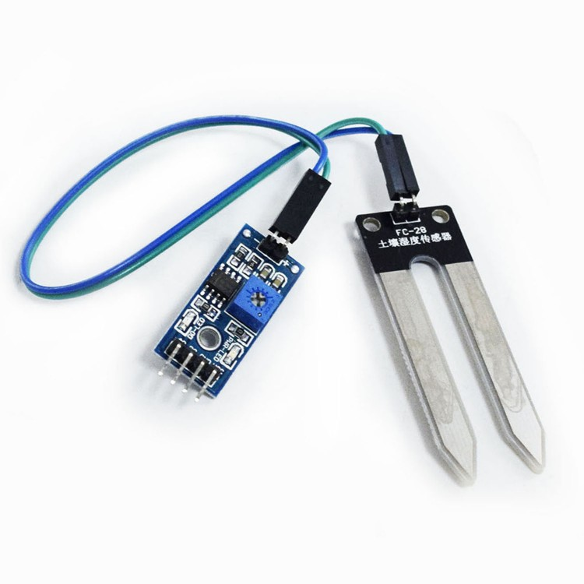

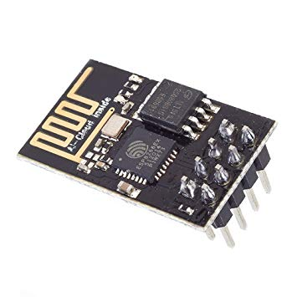
Perception Layer | Network Layer | Application Layer
Soil Moisture Sensor
ESP-8266 Module
Application Interface

Slide 7
Perceptron Model
Sensor Sense and Gather information about the Environment.
Senses physical Parameters or identifies other objects in the Environment.

Slide 8
Network Layer
Responsible for connecting Smart things,Network devices, and Servers.

Slide 9
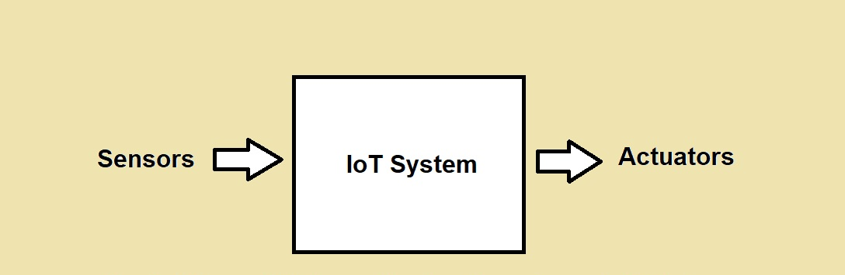
IoT System Flow

Slide 10
Working of the Project
• We connect our system to the internet using a Wi-Fi module.
• We use an Arduino Uno board to send the control signals and to connect to our desired App using Remote XY.
• On the App, two things are displayed:
a) Motor status b) Moisture level

Slide 11
Working (Contd…)
The circuit keeps checking the moisture content of the soil by means of a moisture sensor, and updates the “Moisture level "on the App.
The user can then check the current moisture level from a remote location and control the water supply.
• For this, the user only has to toggle the “Motor status” from ‘ON-OFF’ or ‘OFF-ON’; and the “water pump” will be ‘turned ON’ or ‘turned OFF’ accordingly.
• Thus the ‘soil-moisture’ gets monitored and the ‘water supply’ can be controlled just by the toggling the “Motor status”.
So the user doesn’t have to worry about his crops or plants getting damaged due to ‘water-logging’ or ‘drought’.

Slide 12
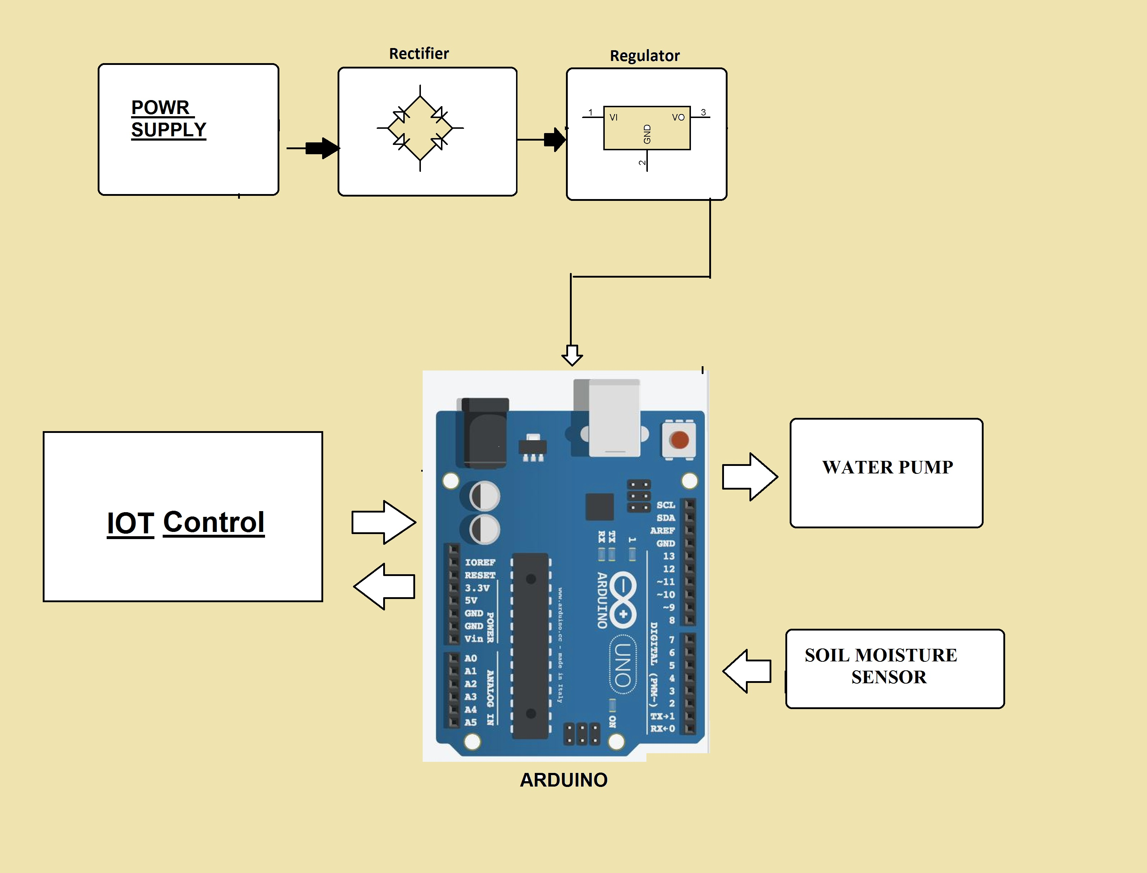

Slide 13
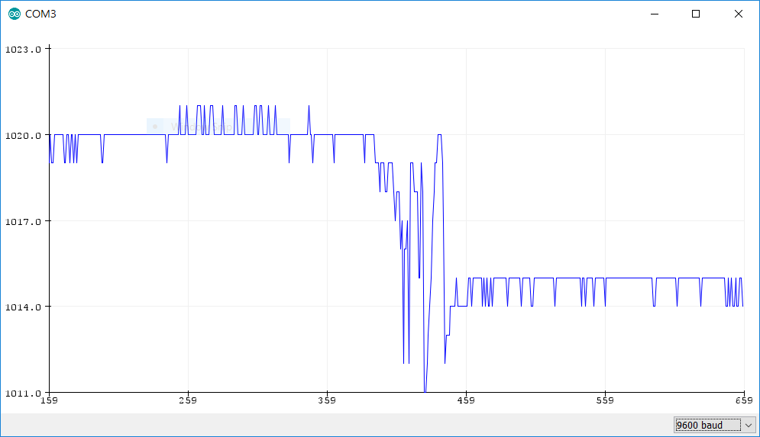
Data Values on Serial Plotter by Soil Moisture Sensor

Slide 14
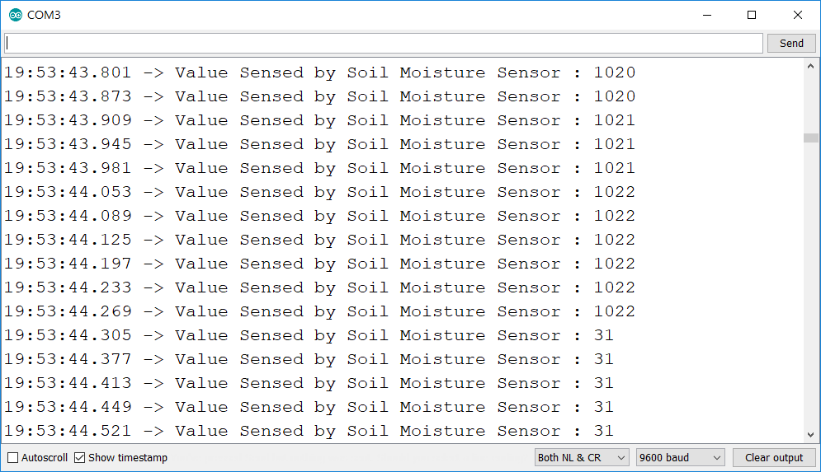
Data values at Serial Monitor

Slide 15
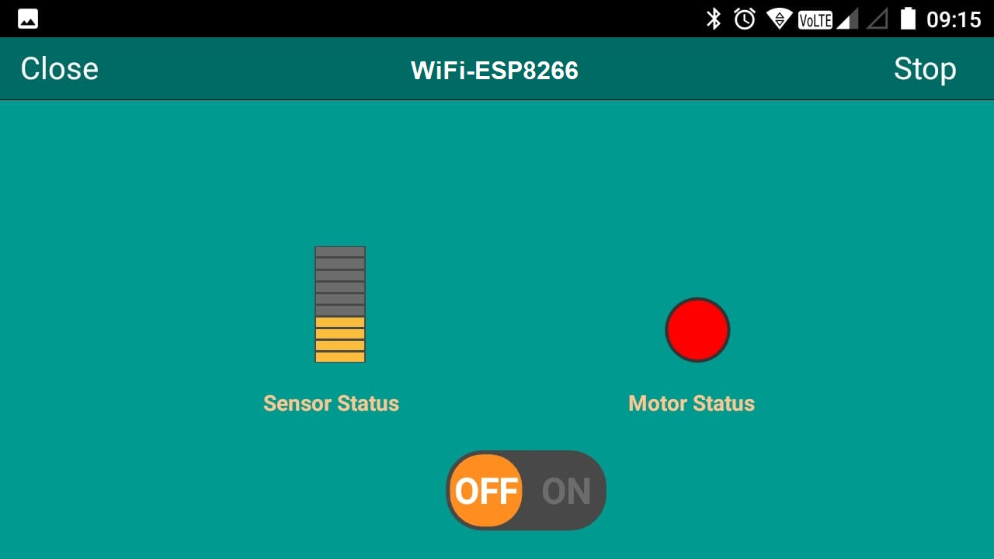
App Interface

Slide 16
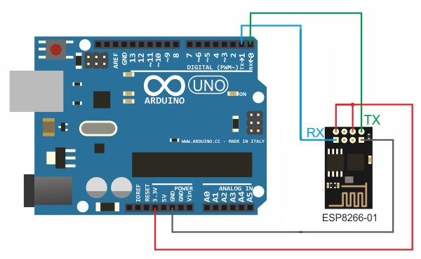
Arduino - ESP8266-01 Connection

Slide 17
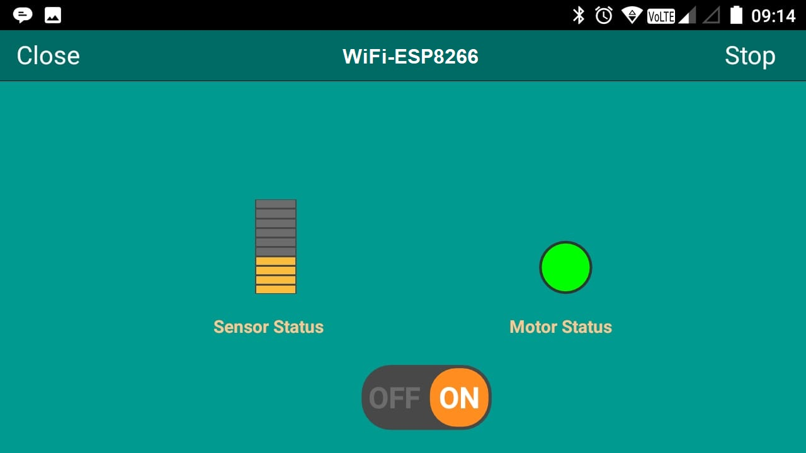
Motor Status ON

